Slide 1
Student Behaviour Analysis
Capstone Project Group 1
Archit Navadiya (0815897)
Dhrumil Patel (0813662)
Bhumit Navadiya (0812548)
Arbaz Shaikh (0823127)
Felix Saji (0803791)

Slide 2
TABLE OF CONTENTS
01
02
03
04
INTRODUCTION
DASHBOARD
05
PROBLEM STATEMENT
KEY INSIGHTS
06
CHALLENGES
DATA COLLECTION & ANALYSIS

Slide 3

INTRODUCTION
We've have completed almost 15 months now. And we all have been through a lot, be it at work or in the college completing assignments and submitting projects and so on.
We all had a different experience while adjusting in our houses and in the college. Some of us had a smooth transition, and some had difficulties. It is believed that demographic factors and past experiences play a significant role in shaping our future academic and living experiences in a new place.
And to gain more insight into this and to know the specific factors that impacts the most, we are analyzing student experience by asking them directly about their feedback.

Slide 4




PROBLEM STATEMENT
This study explores the experiences of Zekelman School of Information and Technology students in areas like demographics, accommodation, convenience, employment, and academics. It aims to identify challenges, improve support systems, and enhance overall satisfaction and success, contributing to a better understanding of student well-being.
Demographics
- program, country, age, gender, etc.
Accommodation & Convenience
- type of accommodation, rent, amenities
Employment & Scholastics
- status, average income, services provided by college

Slide 5

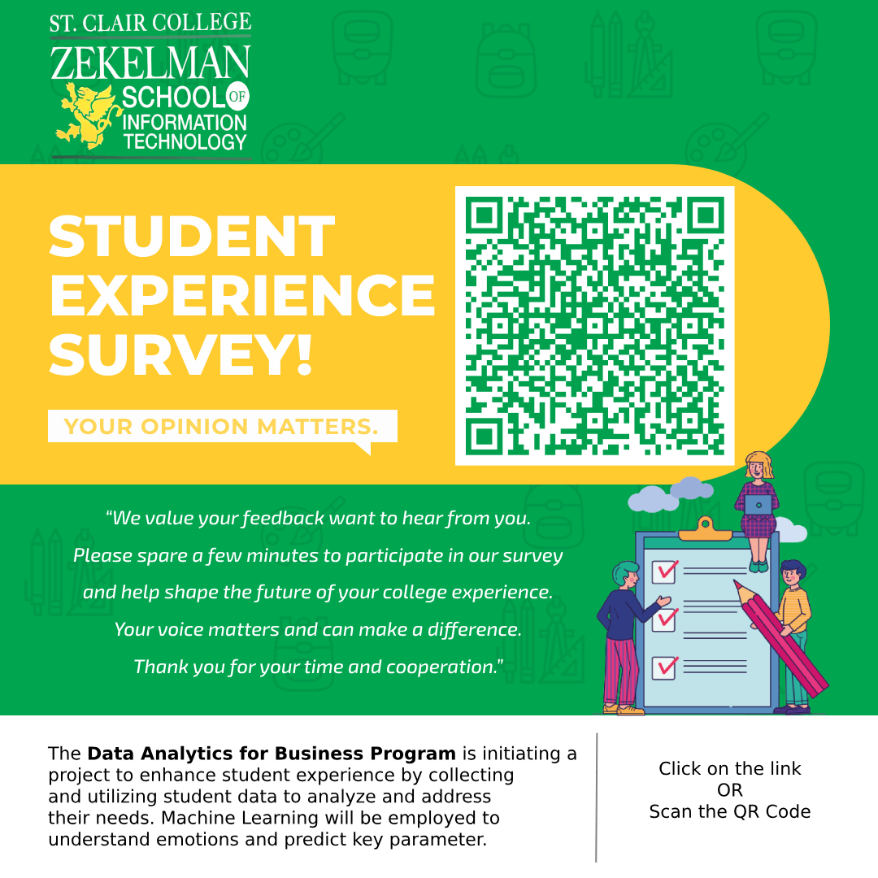



DATA COLLECTION
We gathered the data using Blackboard, where coordinators posted and shared the survey flyer. We shared the flyer on WhatsApp to make sure the survey reached to everyone personally. In class, we spread the word directly. This mix of online and in-person approaches ensured that we hear from everyone, making our survey as inclusive and helpful as possible.
01
02
03

Slide 6





DATA ANALYSIS
Data is collected through Microsoft Forms, stored in an MS Excel file, and analyzed using Python. The insights obtained from the analysis are visually presented using Tableau, facilitating a clear and in-depth understanding of the gathered information. This systematic approach ensures a strong base for knowledge-based decision-making.
01
03
02
04

Slide 7
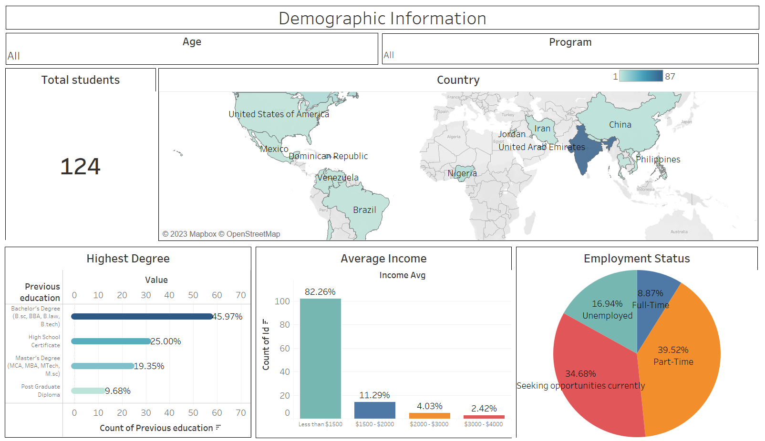
VISUALIZATION

Slide 8
KEY INSIGHTS
Got a total of 150 responses from the students around all the programs till now.
Among all the students, most of them are from India followed by Canada, Nigeria and China having 87, 8, 6, and 4 students, respectively.
Analysis till now shows that Male students are 100% more than that of Female students.
Almost 50% of all the students are employed and other 50% are unemployed or seeking for work opportunities.
80% of them are earning less than $1500 on an average and 2.5% are earning between $3000 and $4000.

Slide 9

CHALLENGES
Getting the data: Survey link not reaching to all the students or getting overlooked which in result makes it difficult to analyze and get accurate insights.
Building a data pipeline:
While transferring the data from MS Excel to Google Cloud Platform and then to Power Automate, a new CSV file is getting generated for each input in the survey.

Slide 10
THANK YOU

